Slide 1


Department of Computer Science and Engineering
DETECTING CROP PATHOGENS
WITH CONVOLUTIONAL NEURAL NETWORKS
LITIKA G 211421104144
HARSHITHA L 211421104095
DHARSHNA SRI M 211421104056
SDG 2 : ZERO HUNGER
Mrs. Sharmila S
Assistant Professor
Dr. Kavitha Subramani
Associate Professor

Slide 2
Abstract
This project presents an approach for detecting crop pathogens using Ensemble Convolutional Neural Networks (CNNs) combining MobileNet, ManualNet, and GoogleNet.
Agricultural crop diseases pose a significant threat to global food security, necessitating rapid and accurate detection methods.
Leveraging the power of deep learning, our proposed system utilizes CNN architectures to analyze images of diseased crops captured in the field
The CNNs are trained on large datasets of annotated images encompassing various crop species and pathogen types, enabling robust and generalized detection capabilities.

Slide 3
Introduction
Detecting crop pathogens is crucial for ensuring agricultural productivity and food security.
With the increasing prevalence of plant diseases due to climate change and global trade, timely and accurate identification of these pathogens has become imperative.
Convolutional Neural Networks (CNNs), a powerful deep learning architecture, have shown remarkable performance in image classification tasks, making them an ideal choice for this application.
By leveraging Ensemble CNNs, we can develop systems that automatically recognize and classify crop pathogens from images, facilitating early intervention and effective management strategies.

Slide 4
Literature Survey
S.No | Title | Year | Authors | Journal | Methodology | Outcome
1 | Towards Scalable Within-Season Crop Mapping With Phenology Normalization and Deep Learning | 2023 | Zijun Yang, Chunyuan Diao, Feng Gao | IEEE Journal of Selected Topics in Applied Earth Observations and Remote Sensing | Review of ML algorithms (CHAID, KNN, Decision Tree, Naive Bayes, Neural Network, Ensemble methods); Hadoop framework for intensive tasks | Achieved over 90% accuracy for end-of-season crop mapping (corn and soybeans), 85% accuracy earlier in growing season; improved scalability and robustness
2 | Crop Recommendation using Machine Learning Techniques | 2022 | Shafiulla Shariff, Shwetha R B, Ramya O G, Pushpa H, Pooja K R | International Journal of Engineering Research & Technology (IJERT) | ML algorithms like KNN, Decision Tree, Naive Bayes, Random Forest, Gradient Boosting used to analyze soil characteristics | Accurate crop recommendations, helps improve productivity and supports sustainable farming

Slide 5
Literature Survey
S.No | Title | Year | Authors | Journal | Methodology | Outcome
3 | Crop Recommendation System using Machine Learning | 2021 | Dhruvi Gosai, Chintal Raval, Rikin Nayak, Hardik Jayswal, Axat Patel | International Journal of Scientific Research in Computer Science, Engineering and Information Technology | IoT-based system with sensors for soil temperature, moisture, pH, NPK; uses Random Forest and CNN | Suggests suitable crops based on soil properties and detects potential plant diseases using CNN
4 | Crop Recommendation System | 2020 | Pradeepa Bandara, Thilini Weerasooriya, Ruchirawya T.H. | International Journal of Computer Applications | Combines environmental detection (Arduino), ML (Naive Bayes, SVM, K-Means Clustering), NLP (Sentiment Analysis) | Predicts suitable crop type based on real-time environmental conditions; ensures high accuracy and efficiency

Slide 6
Literature Survey
S.No | Title | Year | Authors | Journal | Methodology | Outcome
5 | Crop Recommendation using Machine Learning Techniques | 2020 | Shafiulla Shariff, Shwetha R B | International Journal of Engineering Research & Technology (IJERT) | ML algorithms like KNN, Decision Tree, Random Forest, Naive Bayes, Gradient Boosting for soil-based crop recommendation | Suggests crops based on soil features, improving cultivation efficiency
6 | Survey of Crop Recommendation Systems | 2018 | Deepti Dighe, Harshada Joshi, Aishwarya Katkar, Sneha Patil, Prof. Shrikant Kokate | International Research Journal of Engineering and Technology (IRJET) | Survey of ML algorithms (CHAID, KNN, Decision Tree, Naive Bayes, Neural Network); mentions Hadoop framework | Highlights the effectiveness of ensemble models and provides a comprehensive comparison of crop recommendation methods

Slide 7
Problem Statement
Traditional methods for crop disease detection are time-consuming, require expert knowledge, and lack scalability. Farmers face challenges in identifying diseases early, leading to delayed interventions and reduced yields.
There is a need for a scalable, real-time, and accurate system to detect crop pathogens and support proactive measures to ensure food security.

Slide 8
Software / Hardware used
Software Requirements:
Operating System : Windows
Tool : VSCode, Jupyter Notebook
Language : Python3
Hardware requirements:
Processor : Minimum i3 and above
Hard disk : Minimum 300 GB
RAM : Minimum 4 GB

Slide 9
Proposed System
Core Technology:
Utilizes Ensemble Convolutional Neural Networks (CNNs) for precise crop pathogen detection.
Trained on extensive datasets of diseased crop images to recognize subtle pathogen indicators
System Architecture:
Convolutional Layers
Pooling Layers
Fully Connected Layers
Concatenation
Key Enhancements:
Image Transformations
Data Augmentation/ Colour Spacing
Benefits:
Real-time Detection: Facilitates timely intervention to prevent crop damage.
Scalability: Deployable in diverse agricultural settings.

Slide 10
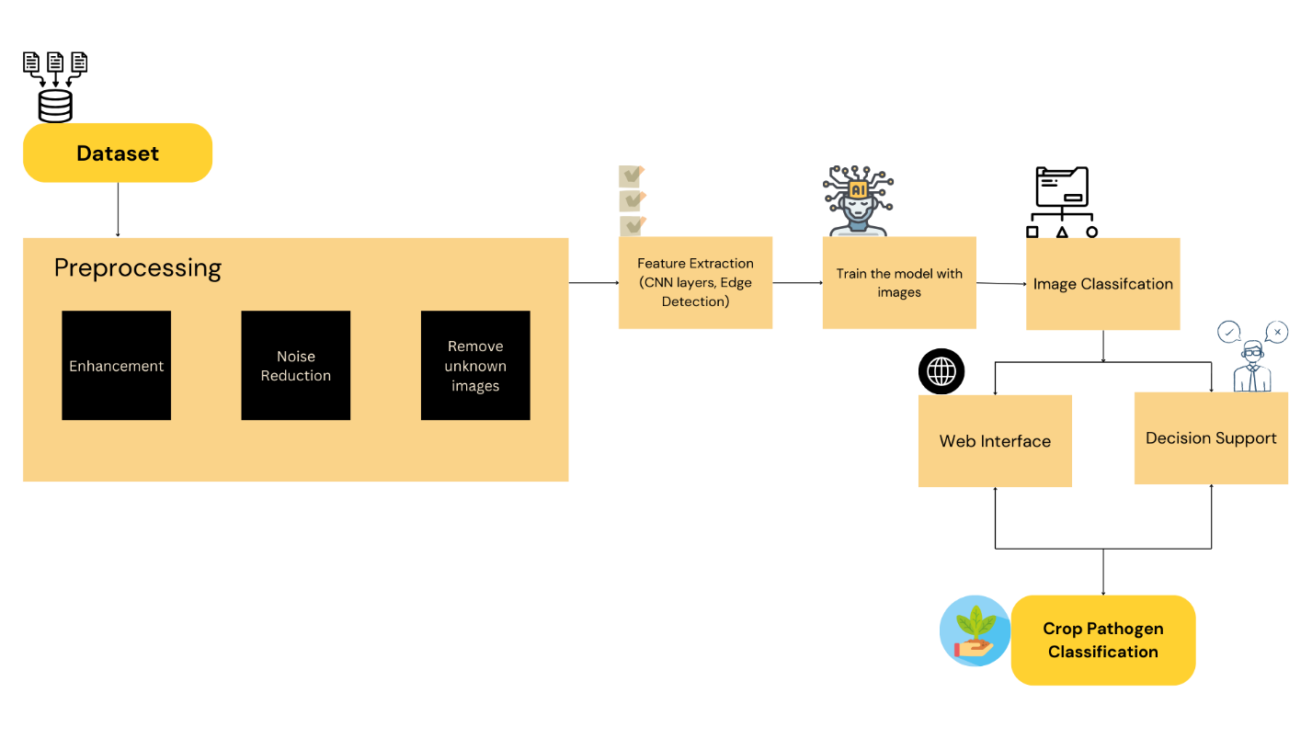
System Architecture

Slide 11




Module Description
1. Manual Net
2. Google Net
3. Mobile Net
4. Ensemble

Slide 12
Module Description
MANUAL NET:
ManualNet is a custom CNN model designed specifically for plant disease classification. Unlike pre-trained networks such as GoogleNet and MobileNet, ManualNet is built from the ground up, focusing on feature extraction relevant to leaf diseases.
The architecture consists of:
Convolutional Layers: Three 3×3 convolutional layers extract hierarchical features.
Batch Normalization & ReLU Activation: Improves training stability and non-linearity.
Max Pooling Layers: Reduces feature map dimensions while retaining key information.
Fully Connected Layers: Two dense layers with dropout regularization for better generalization.
Softmax Output Layer: Classifies diseases into 12 categories based on learned features.

Slide 13
Module Description
GOOGLE NET:
GoogleNet, also known as Inception v1, was introduced by Szegedy et al. and is a deep convolutional neural network (CNN) with 22 layers.
It was designed to optimize computational efficiency while maintaining high accuracy.
The key innovation in GoogleNet is the Inception module, which allows multiple convolutional operations (1×1, 3×3, and 5×5) to be performed in parallel within a single layer.
This enhances the network’s ability to extract both local and global features effectively.
GoogleNet also introduces auxiliary classifiers, which are intermediate softmax classifiers added at different depths of the network. These help in preventing the vanishing gradient problem by ensuring that gradients flow smoothly during backpropagation.
The final layers of GoogleNet include global average pooling (GAP) instead of fully connected layers, significantly reducing the number of trainable parameters while maintaining high classification performance.

Slide 14
Module Description
MOBILE NET:
MobileNet is a lightweight deep learning model optimized for mobile and edge devices. It was designed by Howard et al. and is known for using depthwise separable convolutions, which significantly reduce computational complexity compared to traditional convolutional networks.
Unlike traditional CNNs, MobileNet uses depthwise separable convolutions, significantly reducing the number of parameters and computations without compromising accuracy. This architecture consists of 28 layers, including depthwise and pointwise convolutions, batch normalization, and ReLU activations.
A crucial component of MobileNet is the width multiplier (α) and resolution multiplier (ρ), which control the model’s size and computational complexity. By adjusting these multipliers, MobileNet can balance accuracy and efficiency, making it suitable for real-time plant disease detection in field applications.

Slide 15
Module Description
ENSEMBLE METHOD:
Ensemble learning is employed to further enhance classification accuracy by combining features extracted from multiple models. In this study, GoogleNet and MobileNet are integrated using a feature fusion technique to leverage their strengths:
GoogleNet captures multi-scale features with inception modules.
MobileNet ensures computational efficiency through depthwise separable convolutions.
Ensemble learning improves classification accuracy by combining the strengths of multiple models. In this approach, features extracted from GoogleNet, and MobileNet are fused at the feature level rather than just averaging predictions.
The feature maps from different models are concatenated, allowing the network to leverage diverse representations of disease symptoms.

Slide 16
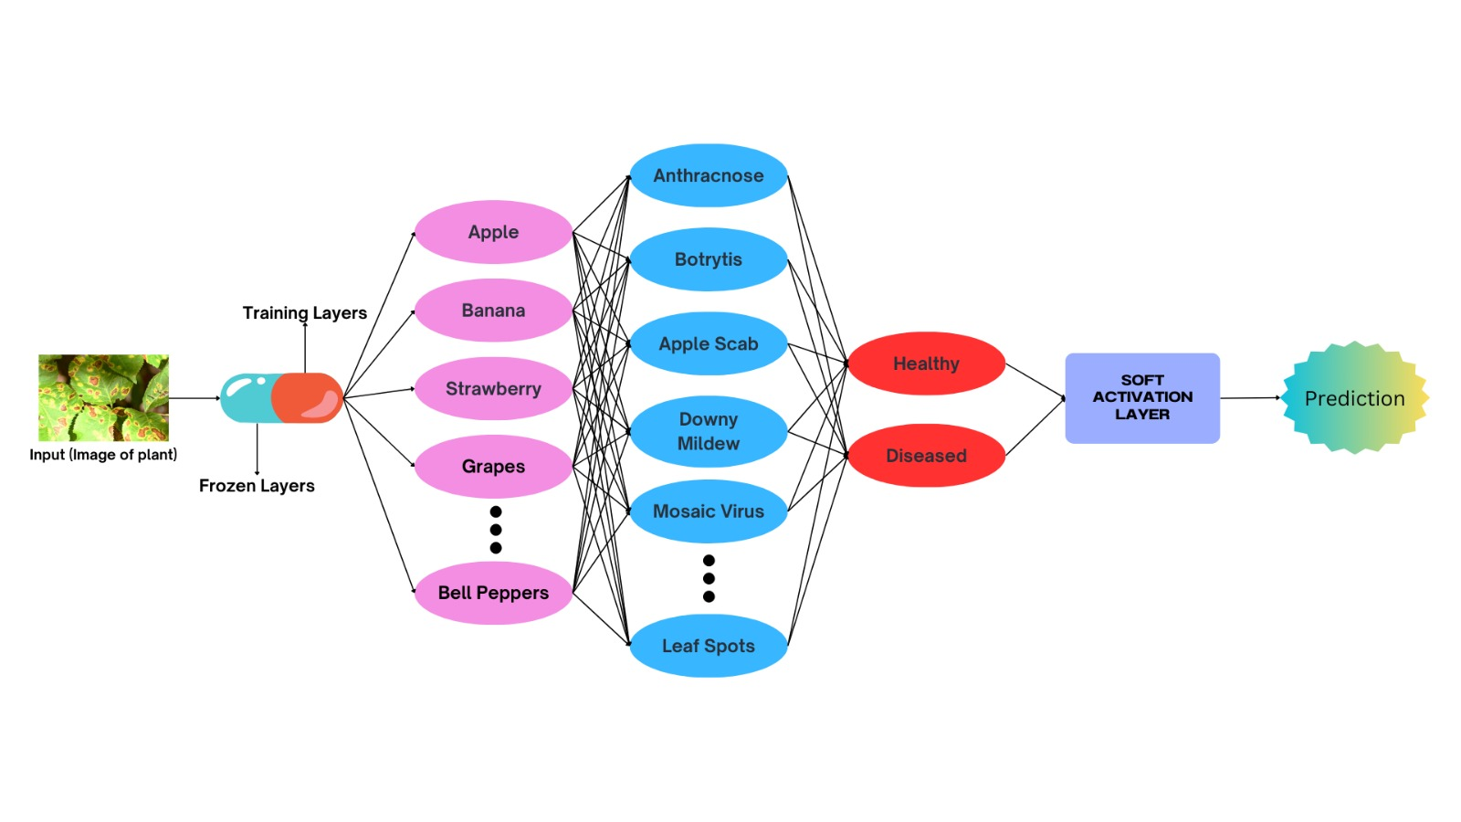
Ensemble Methodology

Slide 17
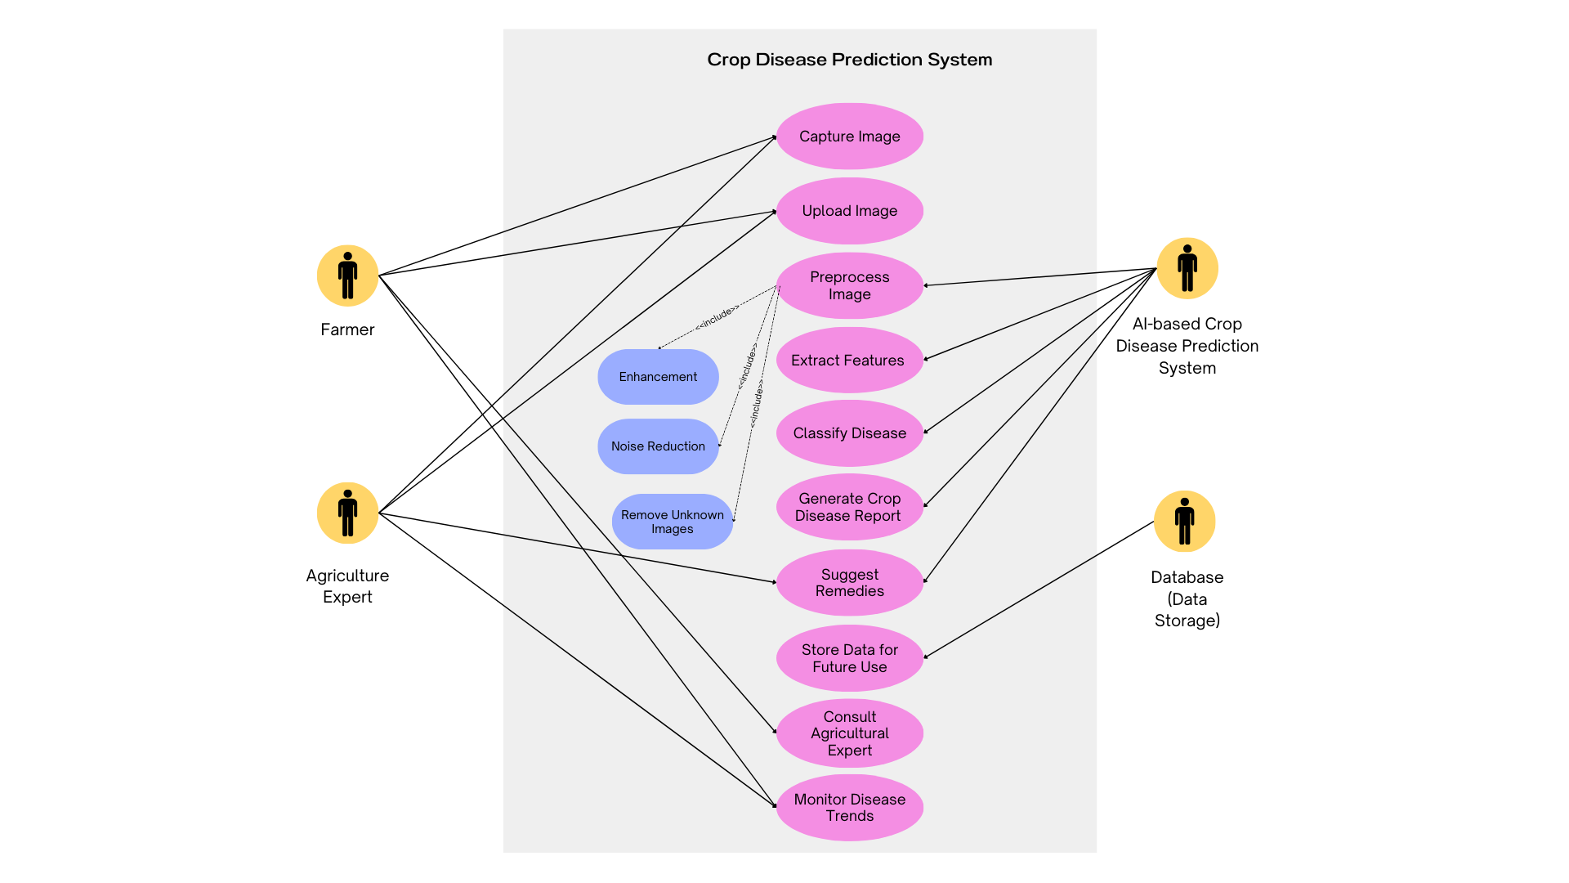
System Design – Use Case Diagram
USE CASE DIAGRAM:

Slide 18
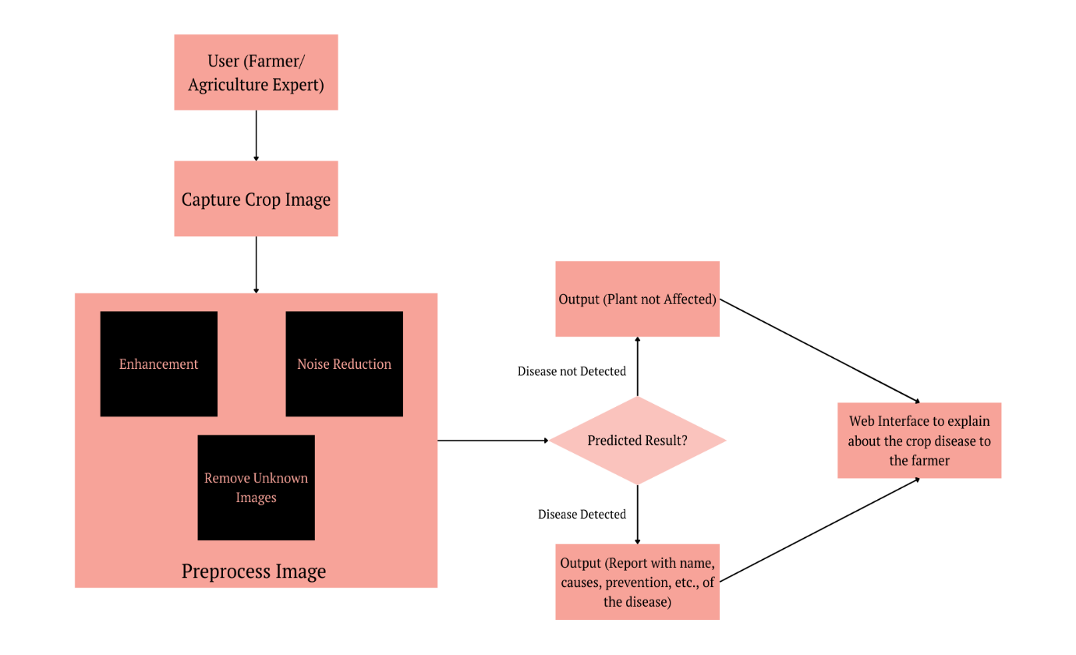
System Design - DFD
DATA FLOW DIAGRAM:

Slide 19
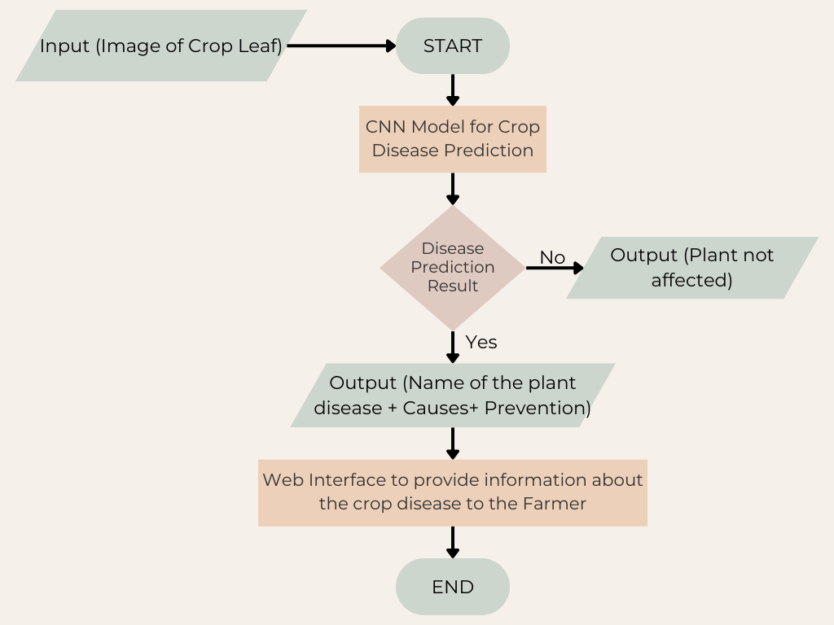
System Design - Flow Chart
FLOW DIAGRAM:

Slide 20
Testing /Performance Evaluation / Results
TEST CASE ID | TEST CASE ACTION TO BE PERFORMED | EXPECTED RESULT | ACTUAL RESULT | PASS/FAIL
1 | User uploads an image of a diseased plant leaf. | Image should be successfully uploaded and pre-processed for analysis. | Image uploaded and pre-processed successfully. | Pass
2 | System classifies the uploaded image using the deep learning models. | Correct disease classification should be displayed. | Disease classified correctly. | Pass
3 | Ensemble model aggregates predictions from individual models. | Final classification should be refined based on multiple models. | Ensemble approach improved accuracy. | Pass

Slide 21
Testing /Performance Evaluation / Results
TEST CASE ID | TEST CASE ACTION TO BE PERFORMED | EXPECTED RESULT | ACTUAL RESULT | PASS/FAIL
4 | User requests additional insights on disease symptoms and possible treatments. | System should display relevant disease details and treatment recommendations. | Insights and remedies displayed accurately. | Pass
5 | User logs into the system with valid credentials. | Successful authentication and redirection to the home page. | User logged in successfully. | Pass
6 | User logs out from the system. | User should be logged out and redirected to the login page. | Logout executed successfully. | Pass

Slide 22
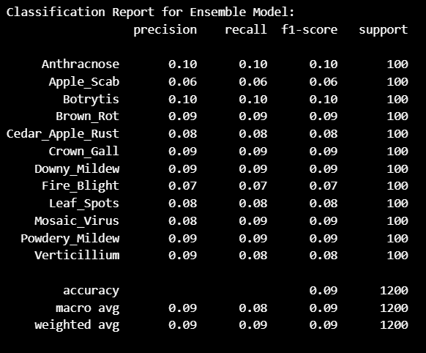
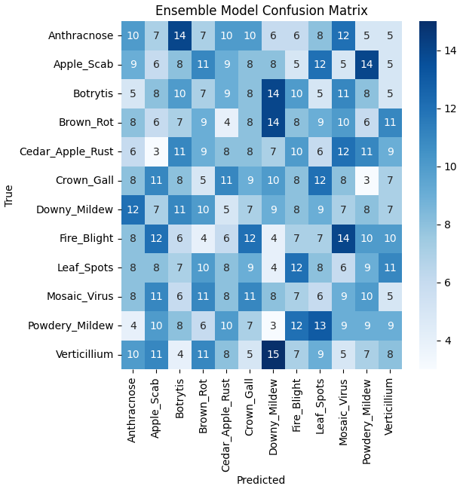
Performance Evaluation / Results
Classification Report:
Confusion Matrix:

Slide 23

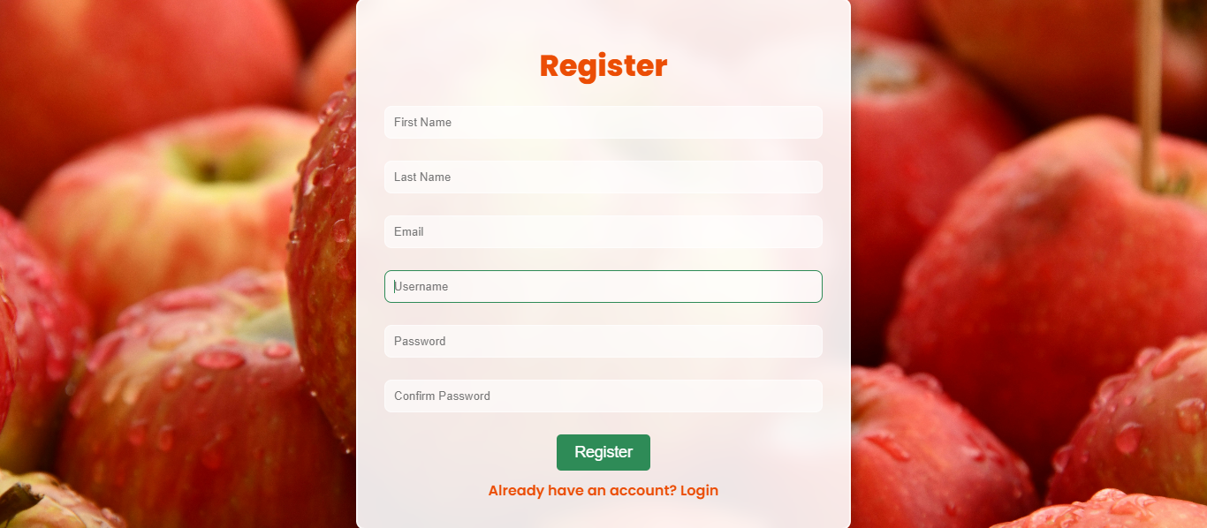
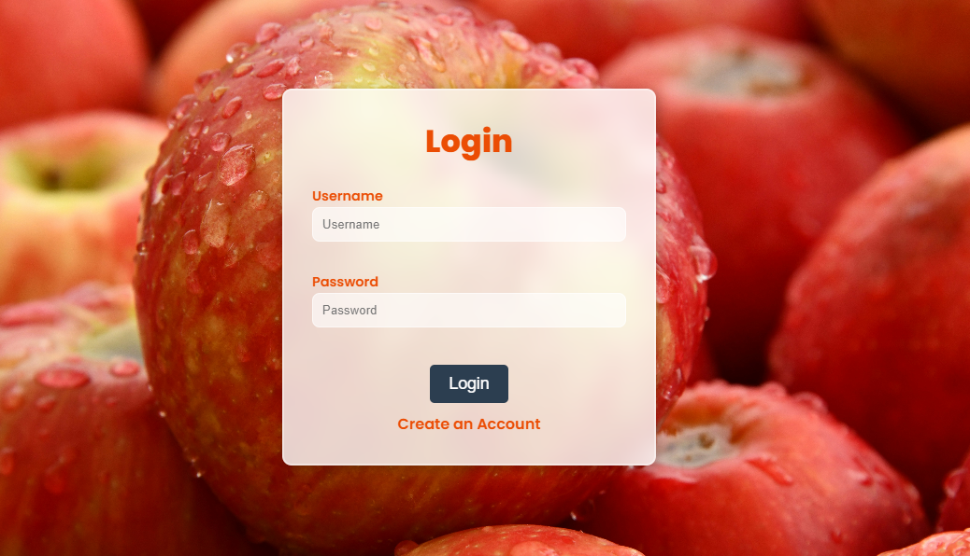

Screen Shots
OUTPUT SCREENSHOT:

Slide 24
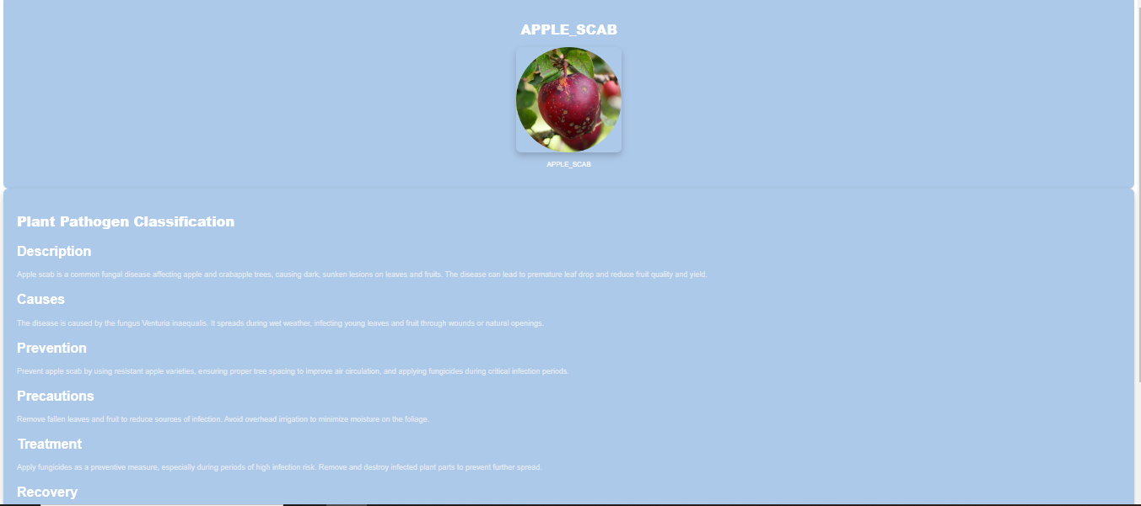
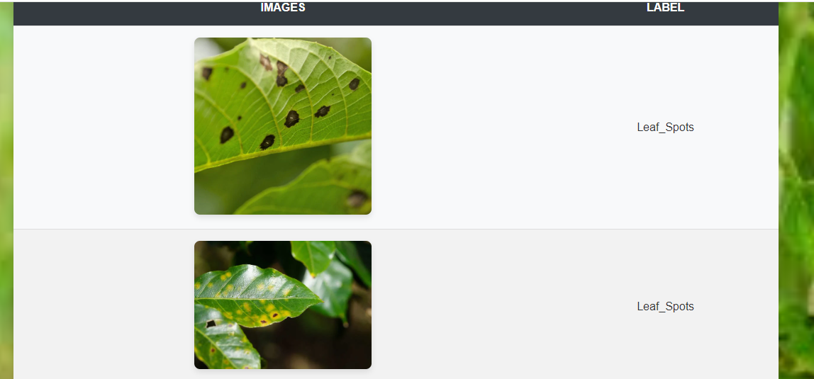
Screen Shots
OUTPUT SCREENSHOT:

Slide 25
Conclusion
Automatically learn features from leaf images for precise pathogen detection.
Scalable solution reducing reliance on manual inspections.
Enables early detection and timely intervention for sustainable farming.
Advances precision agriculture, safeguarding crop health and improving yields
CNN-based models improve the accuracy and speed of crop disease diagnosis.

Slide 26
Feature Enhancement
Improve model generalization for different environments and crop varieties.
Integrate multi-modal data (soil conditions, weather, plant growth stages).
Develop lightweight models for real-time mobile or drone deployment.
Collaborate with agronomists to refine and enhance model robustness.

Slide 27
Reference Paper/ URL
Ammar Oad, Syed Shoaib Abbas, Amna Zafar, Beenish Ayesha Akram, "Plant Leaf Infection Location Using Gathering Learning and Reasonable AI.
Deepti Dighe, Harshada Joshi, Aishwarya Katkar, Sneha Patil, Prof. Shrikant Kokate, "Overview of Trim Suggestion Frameworks," Universal Investigate Diary of Designing and Innovation (IRJET), 2018.
Dhruvi Gosai, Chintal Raval, Rikin Nayak, Hardik Jayswal, Axat Patel, "IoT-enabled framework for soil testing," Universal Diary of Logical Inquire about in Computer Science, Building and Data Innovation, 2021.
Feng Dong, Mir Sajjad Hussain Talpur, and Mueen Uddin, "Machine Learning and Profound Learning for Plant Infection Classification and Detection.
Md. Manowarul Islam, Md Abdul Ahad Adil, Md. Alamin Talukder, Md. Khabir Uddin Ahamed, Md Ashraf Uddin, Md. Kamran Hasan, Selina Sharmin, Md. Mahbubur Rahman, Sumon Kumar Debnath, "DeepCrop: Profound learning-based trim malady forecast with web application.
Minah Jung, Jong Seob Melody, Ah‑Young Shin, Beomjo Choi, Sangjin Go, Suk‑Yoon Kwon, Juhan Stop, Sung Goo Stop, Yong‑Min Kim, "Development of profound learning‑based infection discovery demonstrate in plants

